Slide 1


Slide 2
End term presentation for
Yoga Pose Detection

Slide 3
500069734 R134218123 Pratham Pandey
500068183 R134218125 Pulkit Mittal
500067543 R134218152 Shashwat Chitransh
500068730 R134218206 Karmanya Dadhich
Under the mentorship of
Ms. Shahina Anwarul
Department of Systemics

Slide 4
Introduction
Yoga is a spiritual science which involves physical, mental and spiritual practices aimed at stilling the mind. It has renowned health benefits and is known to improve one's approach towards life. But in order to reap maximum benefits, one needs to ensure that it is done properly.
Computer vision techniques exhibit promising solutions for human pose estimation. We aim at implementing concepts of computer vision to train a machine learning model that can be used to predict yoga pose in real time.
Several methods are used to for pose estimation. Some such methods are DeepPose, OpenPose, PoseNet etc. We plan on using MediaPipe, a cross-platform, customizable ML solutions for live and streaming media, to achieve our aim.

Slide 5
Related Work
DeepPose was the first major paper, published in CVPR 2014 that applied Deep Learning to Human pose estimation. It achieved SOTA performance and beat existing models back in the year 2014.
Efficient Object Localization Using Convolutional Networks uses heatmaps by sliding through multiple subsets of the image (windows) in parallel to simultaneously capture features at a variety of scales. A heatmap predicts the probability of one of the essential points.
Convolutional Pose Machines propose the serial usage of stages to predict. A CPM consists of an image feature computation module followed by a prediction module. The multiple stages can be trained end to end.
The HRNet (High-Resolution Network) model maintains a high-resolution representation throughout the whole process, instead of high → low → high-resolution representation, and this works very well. The architecture starts from a high-resolution subnetwork as the first stage, and gradually adds high-to-low resolution subnetworks one by one to form more stages and connect the multi-resolution subnetworks in parallel.
OpenPose offers realtime Multi-Person 2D Pose Estimation using Part Affinity Fields proposes the detection of multiple people in an image. It uses an approach called non-parametric representation, also known as Part Affinity Fields (PAFs).

Slide 6
Problem Statement
Yoga, if done properly has vast health benefits. But if performed incorrectly it can cause a lot of problems like ankle sprain, stiff neck, muscle pulls, etc. Thus, at least in initial stages yoga must be performed under an experienced instructor. This might not always be possible, owing to expensive yoga classes and social distancing restrictions being imposed around the world.

Slide 7
Objectives
Comparative analysis of different classifiers for Yoga pose classification.
Collection and cleaning of dataset of five poses for yoga pose classification.
Design a classification model for predicting yoga pose accurately
Evaluation of the proposed model
Building an interactive web application for the user.

Slide 8
Methodology
The project involves all the steps involved in a typical ML project. They are:
Loading the dataset
Exploratory data analysis
Data pre-processing
Building the model
Compiling the model
Training the model
Using our model to make predictions
We’ll be building a dataset with 5 poses using a webscraper. Once the dataset is cleaned and processed, we’ll load it and convert the images into required format. We’ll use MediaPipe to find a number of landmarks in the human body and on the basis of the position of those landmarks we’ll determine the pose being performed and use it to train our model. Once the model is trained we’ll use it to predict yoga pose in real time.
We plan on creating a web-application that a user will be able to use for real-time pose prediction.

Slide 9
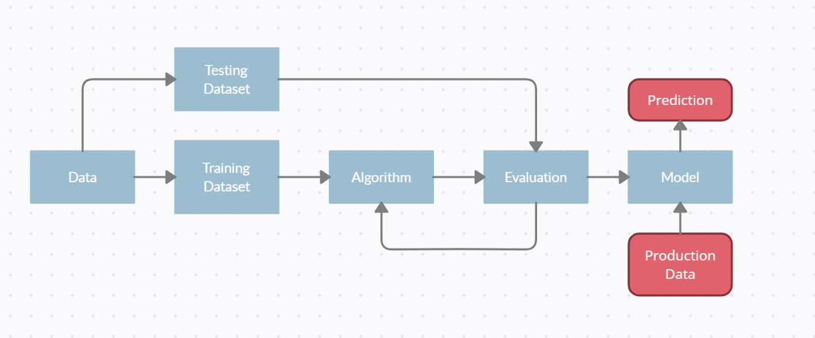
Workflow

Slide 10
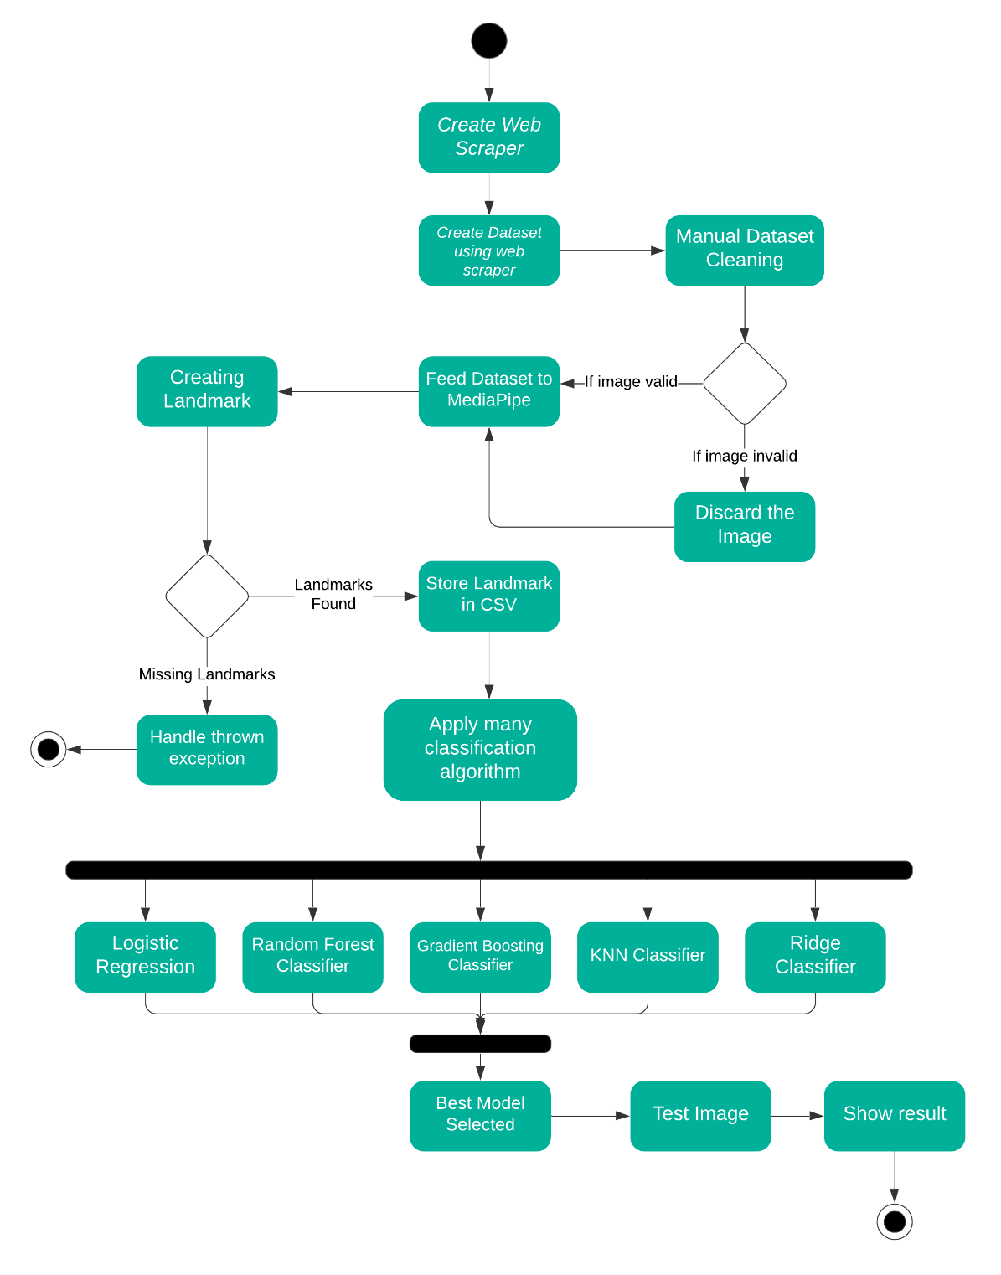
Activity Diagram

Slide 11
Design & Architecture
The project is comprised of multiple components which have been integrated into one to work effectively. The components are as follows:
A webscraper was designed to created to obtain a dataset of images and separate it into five folders as per the requirement of the project.
A piece of code is used to train a model to perform yoga pose detection. It includes loading the mediapipe model to obtain landmarks on the images, taking training dataset as input, data preprocessing, dividing the dataset, creating the model using multiple algorithms and testing the model using certain metrics. This is done with the help of sklearn, matplotlib and opencv.
Now that we’ve trained the model, we need to use the model to perform predictions. This part is done using python in app.py, which includes different functions to take image as input via upload or run a live feed using webcam. The images are handled using opencv. Flask is used to work with the frontend, which is then integrated with HTML pages, styled using CSS and Javascript. Different components of functions have different endpoints which render a certain component according to functionality needed.

Slide 12
Design & Architecture
The HTML component includes three files namely base.html, index.html and webcam.html. base.html contains a basic template for the frontend which is inherited by index.html and webcam.html. Index.html is rendered upon starting the server and opening the page for the project in a web browser. Webcam.html is rendered if webcam function is called from app.py.
CSS is used to beautify the webpage by adding design elements and a beautiful background.
The image request and response are handled using javascript.

Slide 13
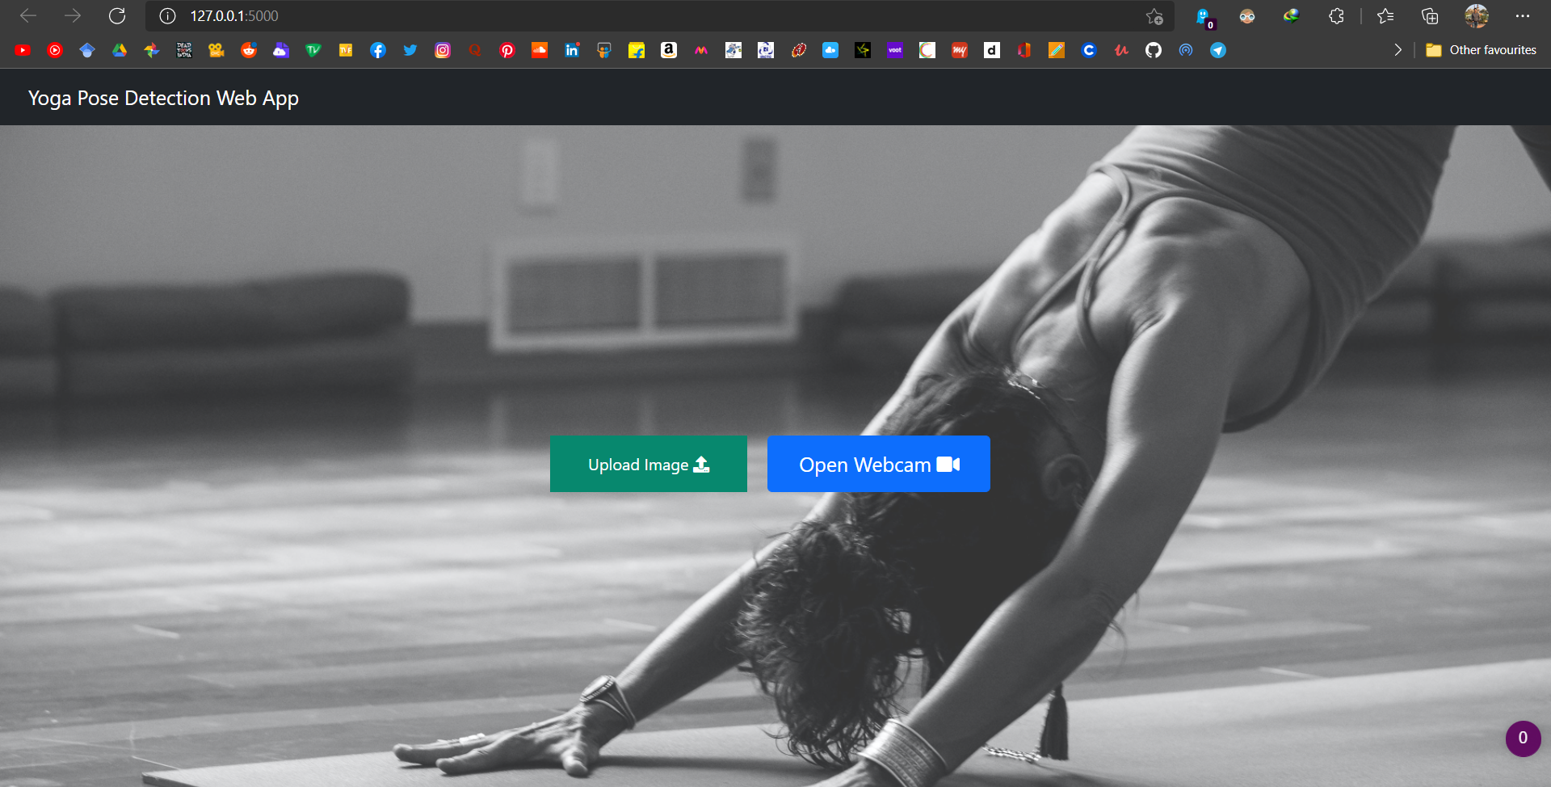
UI

Slide 14
Live Test using video

Slide 15
Future Directions
With the blazing speed at which computer vision is evolving, new pose estimation techniques and models will soon replace the tried and true methods of today. Using better models and techniques in the future for improvement of the model is something we’d certainly be interested in.
Extending our work with a number of other popular yoga poses is also on the cards.
Improving the model we develop with new, improved and thorough datasets could also be possible. Adding a whole new design language to the project by introducing UI elements is also possible. Developing a web application or a native app will also help in the distribution of this idea.

Slide 16
Conclusion
The world has seen a tremendous rise in fitness community over the past decade. People from all walks of life are becoming much more conscious about their general health. Yoga has turned out to be a go-to choice for many but with the digital age looming on us, people find it difficult to properly learn and perform yoga with correct posture. Performing any pose with incorrect body posture can not only waste ones time & efforts but it can also prove to be quite counterproductive for your body as it increases risk of several muscle injuries. This problem can be avoided by creating a system that intelligently detects your current form and helps in rectifying it, thus ensuring that an individual gets maximum benefits out of their hardwork.
In our project we use MediaPipe to determine the accuracy of a yoga pose. MediaPipe analysis all available landmarks in human body & their position relative to each other in order to quantify the correctness of body posture. Our work will have a positive impact on all fitness-enthusiasts who will be able to easily judge the accuracy of their favourite Yoga-Pose and live with a healthy and sustainable lifestyle.

Slide 17
References
[1] Zhang, F., Bazarevsky, V., Vakunov, A., Tkachenka, A., Sung, G., Chang, C.L. and Grundmann, M., 2020. Mediapipe hands: On-device real-time hand tracking. arXiv preprint arXiv:2006.10214.
[2] Henry Hollis, "Using computer vision to rate yoga poses" medium.com https://medium.com/@hollhc17/using-computer-vision-to-rate-yoga-poses-90a5dcb9aabe (accessed on 25th Sep)
[3] Kleinbaum, D.G., Dietz, K., Gail, M., Klein, M. and Klein, M., 2002. Logistic regression (p. 536). New York: Springer-Verlag.
[4] Svetnik, V., Liaw, A., Tong, C., Culberson, J.C., Sheridan, R.P. and Feuston, B.P., 2003. Random forest: a classification and regression tool for compound classification and QSAR modeling. Journal of chemical information and computer sciences, 43(6), pp.1947-1958.
[5] Tony Yiu, "Gradient Boosting Classification explained through Python" medium.com https://towardsdatascience.com/gradient-boosting-classification-explained-through-python-60cc980eeb3d
[6] Zhang, Min-Ling, and Zhi-Hua Zhou. "ML-KNN: A lazy learning approach to multi-label learning." Pattern recognition 40, no. 7 (2007): 2038-2048
[7] DataTechNotes: Classification Example with Ridge Classifier in Python
[8] Chiddarwar, G.G., Ranjane, A., Chindhe, M., Deodhar, R. and Gangamwar, P., 2020. AI-based yoga pose estimation for android application. Int J Inn Scien Res Tech, 5, pp.1070-1073.
[9] KUTÁLEK, J., DETECTION OF A YOGA POSES IN IMAGE.
[10] Jose, J. and Shailesh, S., 2021, March. Yoga Asana Identification: A Deep Learning Approach. In IOP Conference Series: Materials Science and Engineering (Vol. 1110, No. 1, p. 012002). IOP Publishing.

Slide 18
THANK YOU

